Slide 1

Imaging Small, Discrete Scatterers Through Aberrating Media Using DORT with Synthetic Wavelengths
Thesis Defense
Michael Joseph S. Lee
Notes:
Hello. My name is Michael Lee and I shall be presenting on a technique for imaging small, discrete scatterers through aberrating media.

Slide 2
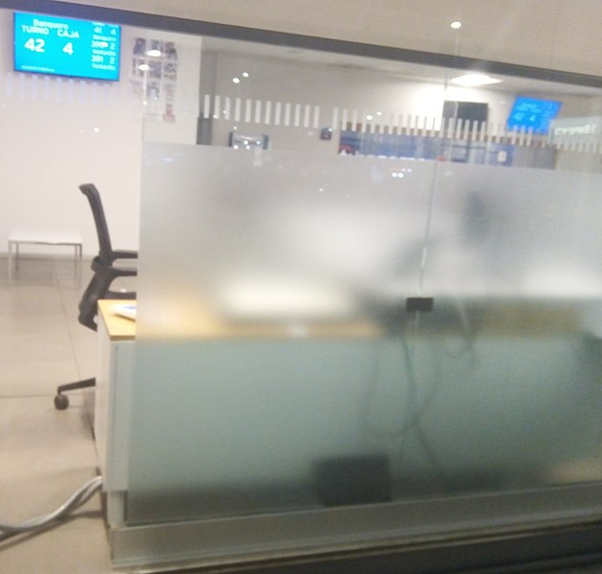
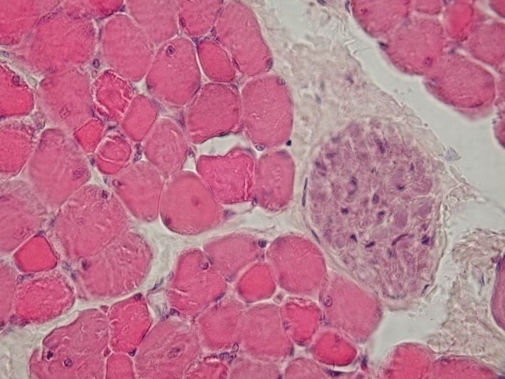
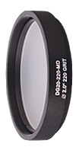
General Goal
Image through aberrating media
Want to do this without needing an explicit model for the aberrating media
***
*
**
Tissue
Optical Diffuser
Frosted Glass
*Image Source: https://commons.wikimedia.org/wiki/File:Skeletal_muscle_-_cross_section,_nerve_bundle.jpg
**Image Source: https://www.thorlabs.com/Images/GuideImages/6905_GGDiffusers_5.jpg
***Image Source: https://commons.wikimedia.org/wiki/File:Translucent_Glass.jpg
Notes:
Imaging through aberrating media is a difficult, yet useful task. For example, one might want to see through bodily tissue or a pane of frosted glass. However, in those cases, light gets aberrated, potentially making it difficult to get clear images. It would be nice to be able to see through such aberrating media.

Slide 3
Outline of this talk
Background
Transfer matrices
Synthetic wavelengths
Synthetic Wavelength DORT (SW-DORT)
Explanation
Results
Conclusion
Notes:
So how does one image through aberrating media? Well, there is a fair amount of literature on that. However, this work focuses on a specific methodology called synthetic wavelength DORT, or SW-DORT for short.
In order to properly explain synthetic wavelength DORT, some background will first be given. Then, synthetic wavelength DORT will be presented.

Slide 4
Transfer Matrices BACKGROUND
Notes:
Now, in order to give a proper explanation about what was done in this work, some background is needed.
First, some background on transfer matrices.

Slide 5
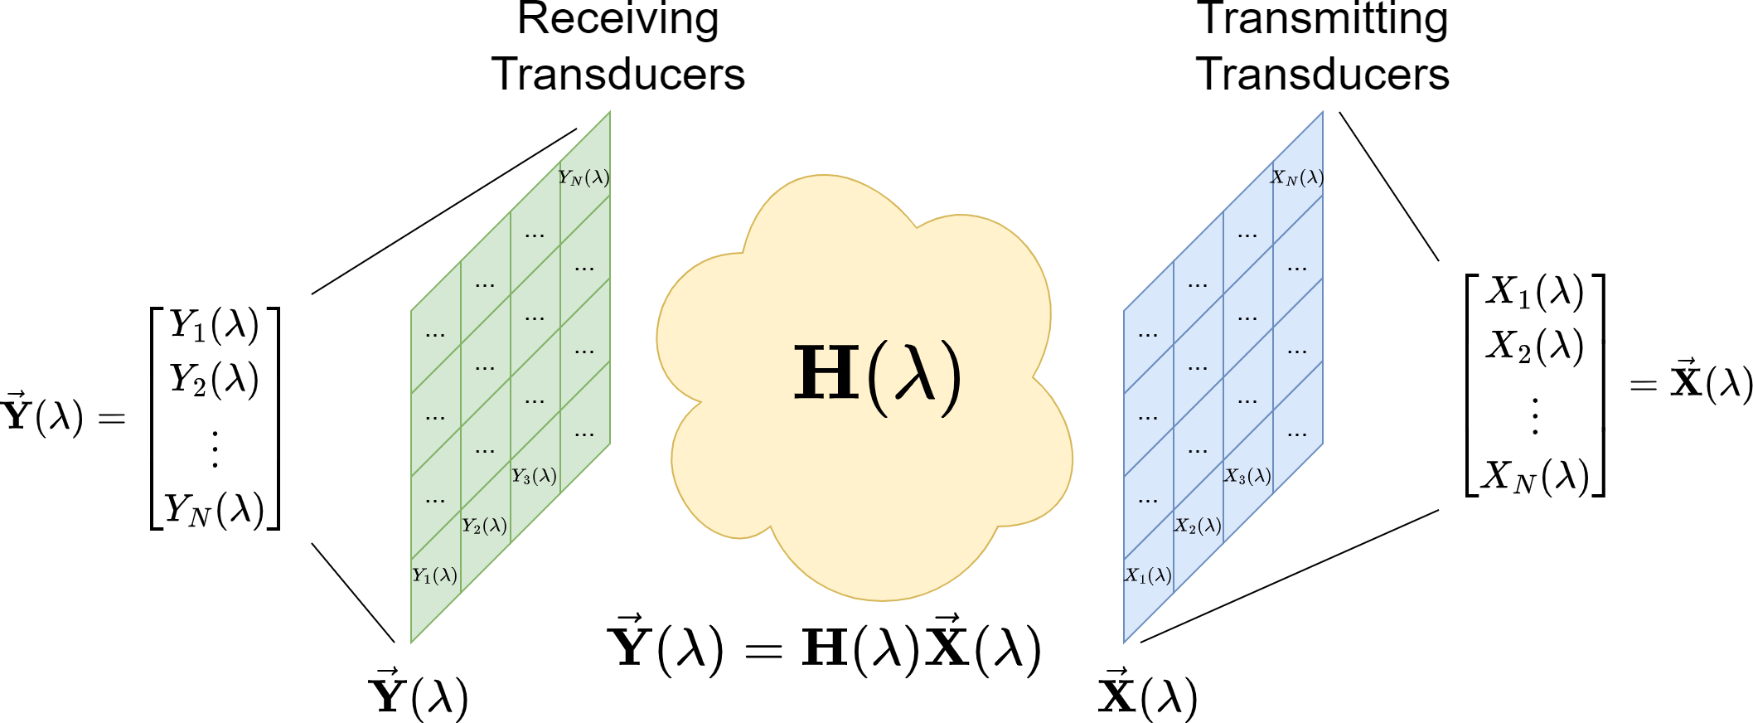
Transfer Matrix – General
Notes:
In general, transfer matrices relate a set of input signals to a set of output signals. In our case, roughly speaking, the transfer matrix relates a set of transmitted signals to a set of received signals in the frequency domain. Each received signal can be expressed as a linear combination of the input signals.

Slide 6
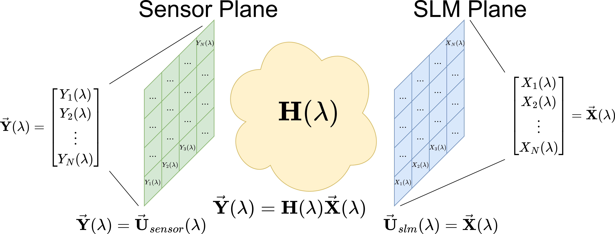
Transfer Matrix – Example
Notes:
In our particular case, the transmitted signals will be derived from the output of a spatial light modulator, or SLM for short. The received signals will be derived from the complex field incident on a camera sensor. Put differently and imprecisely, the transfer matrix relates the output of an SLM to the input to a camera sensor.
Note that in the diagram on the slide, light goes from right to left, starting at the SLM plane and ending at the sensor plane.

Slide 7
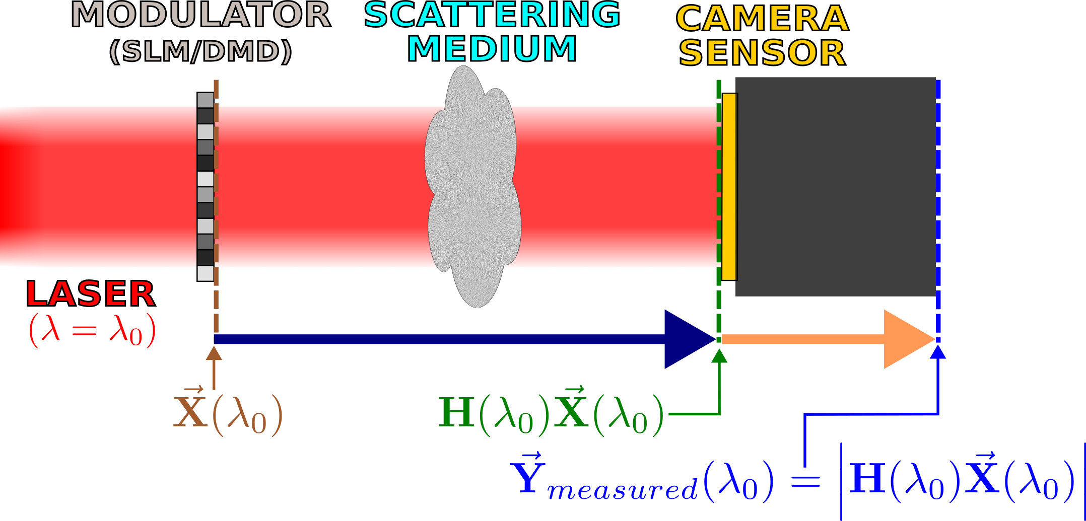
Transfer Matrix Measurement Process (For The Optical Regime)
Interferometric method in [1]
Computational optics-based method in [2] and [3]
Simplified Setup
[1] Boccara, and S. Gigan, “Measuring the transmission matrix in optics: An
approach to the study and control of light propagation in disordered media,”
Physical Review Letters, vol. 104, no. 10, 2010.
[2] C. A. Metzler, M. K. Sharma, S. Nagesh, R. G. Baraniuk, O. Cossairt, and A.
Veeraraghavan, “Coherent inverse scattering via transmission matrices:
Efficient Phase Retrieval Algorithms and a public dataset,” 2017 IEEE
International Conference on Computational Photography (ICCP), 2017.
[3] M. K. Sharma, C. A. Metzler, S. Nagesh, R. G. Baraniuk, O. Cossairt, and A.
Veeraraghavan, “Inverse scattering via transmission matrices: Broadband
illumination and fast phase retrieval algorithms,” IEEE Transactions on
Computational Imaging, vol. 6, p. 95–108, 2020.
Notes:
In acoustics, radio frequency, i.e. RF, and microwaves, one can directly sample waveforms in time. This makes the process of measuring transfer matrices much simpler.
However, in optics, it is more difficult to measure transfer matrices. One cannot directly sample waveforms at optical frequencies. Moreover, typical camera sensors do not measure phase information---they only measure intensity.
So how does one measure transfer matrices in the optical regime?
One can use interferometry to measure a transfer matrix, like in source [1]. However, interferometric methods can be sensitive to vibrations and they require a reference to be used.
Another method for measuring the transfer matrix is given in sources [2] and [3]. This method uses computational optics rather than interferometry. A simplified setup for the method is shown on this slide. The method involves projecting patterns onto an SLM, measuring the resulting intensity images on the camera sensor, and then performing phase recovery---this is a drastic oversimplification, however. If you would like to know more details, please read sources [2] and [3].

Slide 8
DORT Background
DORT – Decomposition of the Time-Reversal Operator
Notes:
Now, here is some background on DORT.

Slide 9
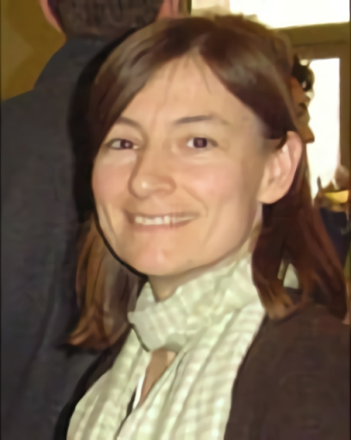
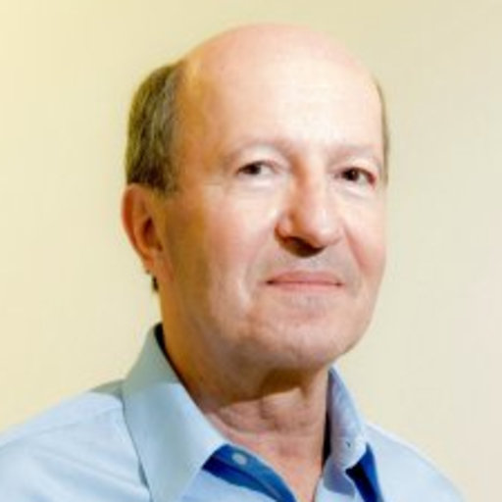
DORT Background
DORT – French acronym that means “decomposition of the time-reversal operator”
Arose from the study of acoustic time-reversal mirrors
Invented by Claire Prada in the 1990s
Claire Prada
Mathias Fink
(Claire Prada’s Advisor)
Notes:
DORT is a French acronym that means “decomposition of the time-reversal operator”. The name, while accurate, does not tell one much about how DORT is actually performed. No explicit time-reversal is performed when performing DORT.
The DORT technique can be used to image scatterers of waves and to selectively focus on scatterers.

Slide 10
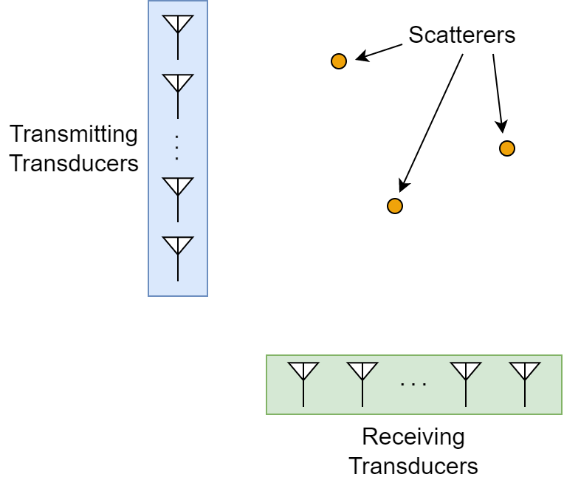
General Setup for DORT
Notes:
The general setup for DORT involves having a set of transmitting transducers and a set of receiving transducers. The transmitting transducers transmit signals, and the receiving transducers receive signals. The transmitting transducers excite a medium that contains scatterers of waves. Oftentimes, the case of separate, small, discrete scatterers is considered.

Slide 11
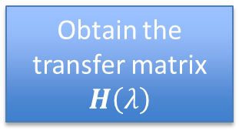



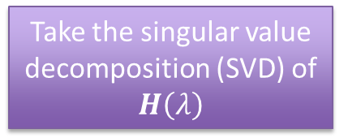
Performing DORT
Results of DORT
DORT
Left-singular vectors
$$\left\{u_{i}\left(λ\right)\right\}$$
Obtain the transfer matrix $H\left(λ\right)$
Take the singular value decomposition (SVD) of $H\left(λ\right)$
Right-singular vectors
$$\left\{v_{i}\left(λ\right)\right\}$$
Singular values
$$\left\{σ_{i}\left(λ\right)\right\}$$
Notes:
In order to perform DORT, one must first obtain the transfer matrix $H\left(λ\right)$. DORT is then performed by taking the singular value decomposition, or SVD, of the transfer matrix $H\left(λ\right)$. This gives a set of right-singular vectors, left-singular vectors, and singular values.

Slide 12
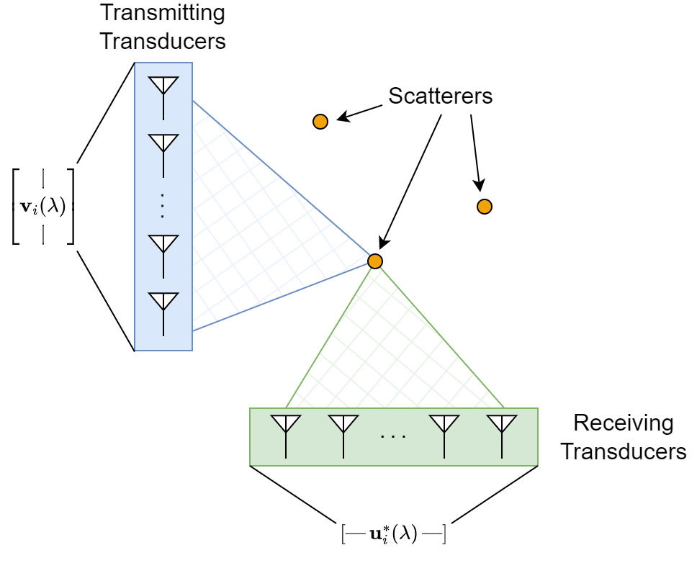
Singular Vectors and Singular Values from DORT
Singular vectors from DORT tell one how to beamform to focus on individual scatterers*
Components of singular vectors are used to determine amplitudes and phases of individual elements
Singular values relate to scattering strength*,**
*Under certain conditions, i.e. “ideally-resolved” scatterers; see [4].
**Roughly speaking; see [4].
[4] M. Fink and C. Prada, Detection and Imaging in Complex Media with the D.O.R.T. Method, pp. 107–134.
Springer Berlin Heidelberg, 2002. From the book titled Imaging of Complex Media with acoustic and seismic waves.
Notes:
Under certain conditions, namely “ideally-resolved” scatterers, the singular vectors tell one how to beamform to focus on individual scatterers. One can backpropagate singular vectors to selectively focus on scatterers. Under those same conditions, the singular values are related to the scattering strength of each scatterer.
The right-singular vectors can be backpropagated from the transmitting transducers to selectively focus using the transmitting transducers. The complex conjugates of the left-singular vectors can be backpropagated from the receiving transducers to selectively focus using the receiving transducers.
One can backpropagate these selectively focusing signals and observe the resulting field patterns. For each pattern from a backpropagated singular vector, one will ideally see the fields get intense around a single scatterer’s location.

Slide 13
Synthetic Wavelengths Background
Notes:
Now for some background on synthetic wavelengths.

Slide 14
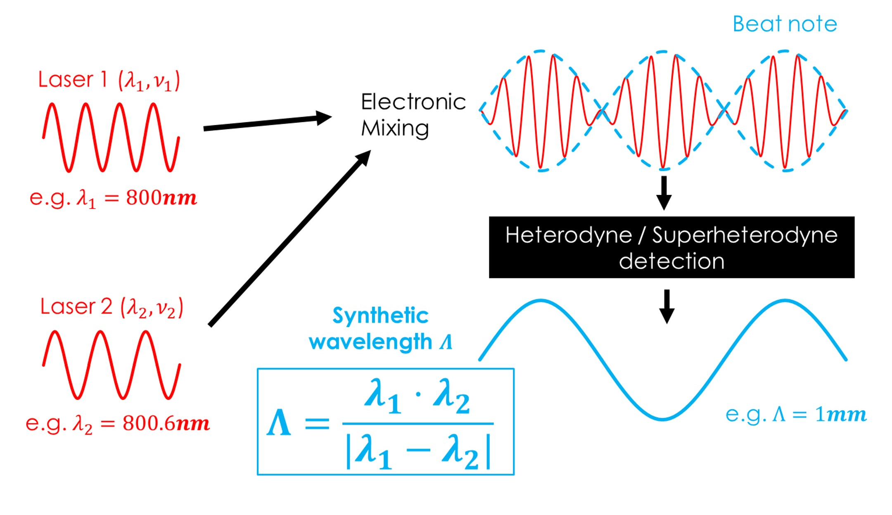
Main Idea
Heterodyne/mix two fields at nearby wavelengths to obtain a longer effective wavelength
Image source: https://3dim.northwestern.edu/project/swh/
Notes:
The main idea of synthetic wavelengths is to heterodyne or mix two fields at nearby wavelengths to obtain a longer effective wavelength. This longer wavelength is more resilient to path length aberrations.

Slide 15
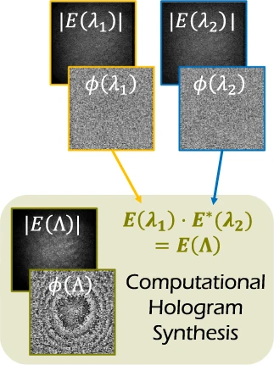
Generating Synthetic Fields
Image Credit
Image adapted from [5]
Can be backpropagated,
e.g. like in [5]
[5] F. Willomitzer, P. V. Rangarajan, F. Li, M. M. Balaji, M. P.
Christensen, and O. Cossairt, “Fast non-line-of-sight imaging
with high-resolution and wide field of view using synthetic
wavelength holography,” Nature Communications, vol. 12,
p. 6647, Nov 2021.
Notes:
One can generate a synthetic field by multiplying one complex field at one wavelength by the complex conjugate of another field at a nearby wavelength. This creates a synthetic field. In certain cases, like the case in source [5], this synthetic field can be backpropagated at the synthetic wavelength to form images.

Slide 16
More Information on Synthetic Wavelengths
[5] F. Willomitzer, P. V. Rangarajan, F. Li, M. M. Balaji, M. P. Christensen, and O. Cossairt, “Fast non-line-of-sight imaging with high-resolution and wide field of view using synthetic wavelength holography,” Nature Communications, vol. 12, p. 6647, Nov 2021.
[6] Y. Wu, F. Li, F. Willomitzer, A. Veeraraghavan, and O. Cossairt, “WISHED: Wavefront imaging sensor with high resolution and depth ranging,” 2020 IEEE International Conference on Computational Photography (ICCP), 2020.
Notes:
There is a lot more to synthetic wavelengths than what I have presented. For more information on synthetic wavelengths, please see the sources shown on the slides.

Slide 17
Synthetic Wavelength DORT
SW-DORT
Notes:
Now that the background is done, I shall now describe some of the work that I have done.
The work I have done can be referred to as “synthetic wavelength DORT”, or “SW-DORT”.
Synthetic wavelength DORT combines DORT with synthetic wavelengths to perform imaging.

Slide 18
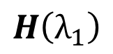
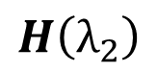
Synthetic Wavelength DORT Process
$$H\left(λ_{1}\right)$$
DORT
Derive fields from singular vectors
Generate synthetic field
$$H\left(λ_{2}\right)$$
Backpropagate synthetic field
Scatterer Image
Notes:
Synthetic wavelength DORT requires that one has the transfer matrix for two closely spaced wavelengths.
DORT is performed, yielding a set of singular vectors.
One takes a pair of singular vectors, and from those singular vectors, derives fields.
These fields are then used to derive a synthetic field.
The synthetic field is then backpropagated, and images are obtained.

Slide 19
Imaging Through Aberrating Media With Synthetic Wavelength DORT Simulation
Notes:
For a more concrete example of synthetic wavelength DORT, I shall describe a simulation that was done that uses synthetic wavelength DORT. In this simulation, small, discrete scatterers are imaged through an aberrating medium using synthetic wavelength DORT.

Slide 20
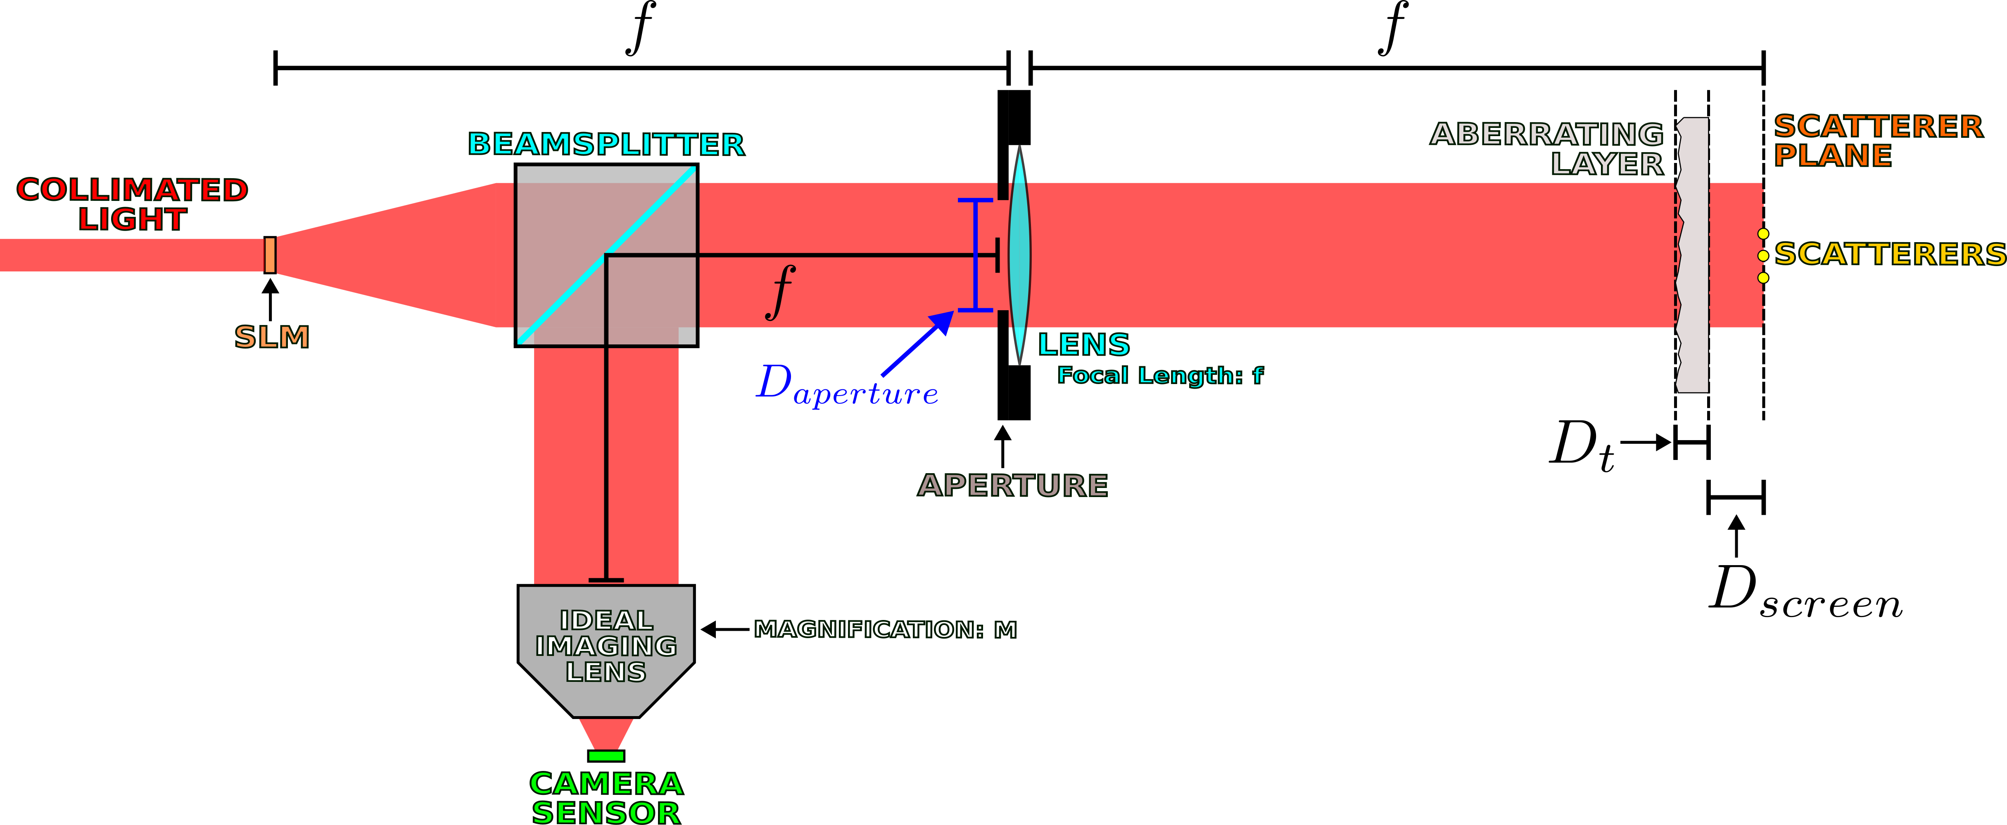
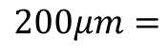
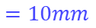
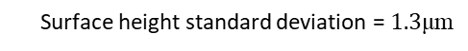
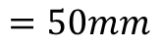
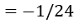
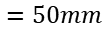
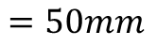
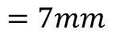
Simulated Setup
$$=50mm$$
$$=50mm$$
$$=50mm$$
$$=50mm$$
$$=10mm$$
$$200μm=$$
Surface height standard deviation = $1.3\text{μ}\text{m}$
$$=−1/24$$
$$=7mm$$
Scatterers are on the order of 0.01mm in diameter
Notes:
The simulated setup is essentially a Fourier transforming lens setup. The input, i.e. the output of a spatial light modulator, is located in the front focal plane, and the scatterers are located in the back focal plane. The scatterers are on the order of 0.01mm in diameter. Between the lens and scatterers is an aberrating layer that is 200 micrometers thick. That aberrating layer has a surface height standard deviation of 1.3 micrometers.
The transfer matrix relates the SLM output to the incident field on the camera sensor. Since everything here was done in simulation, both phase and amplitude could be measured, thus making it easier to measure the transfer matrix---there was no need to go through any of the methodologies given in sources [1] through [3] because phase could be directly measured in simulation.

Slide 21
Limitations of the Simulation
Aberrating layer model [7] limitations
Scalar wave approximation
Other limitations
Scatterer model limitations
Incomplete modeling of beamsplitters
[7] J. W. Goodman, Statistical Optics. Wiley, 2nd ed., 2015. Sections 7.1.1 and 8.2.
Notes:
However, there are limits to this simulation.
First of all, scalar waves are simulated. This is not entirely accurate to reality as electromagnetic waves are vector waves.
The aberrating layer model is a random thickness model that follows what is described in source [7], J. W. Goodman’s Statistical Optics book. The model is implemented as a phase mask, where the phase shift is commensurate with, i.e. proportional to, the thickness at a point. This model assumes a thin structure and/or paraxial rays.
Scatterers are modeled as opaque spots on an amplitude mask, which might not be the best model of a scatterer.
Partial reflection and transmission from beamsplitters is also not modeled.
These are just some of the limitations of the model I used for my simulation. There are other limitations as well.

Slide 22
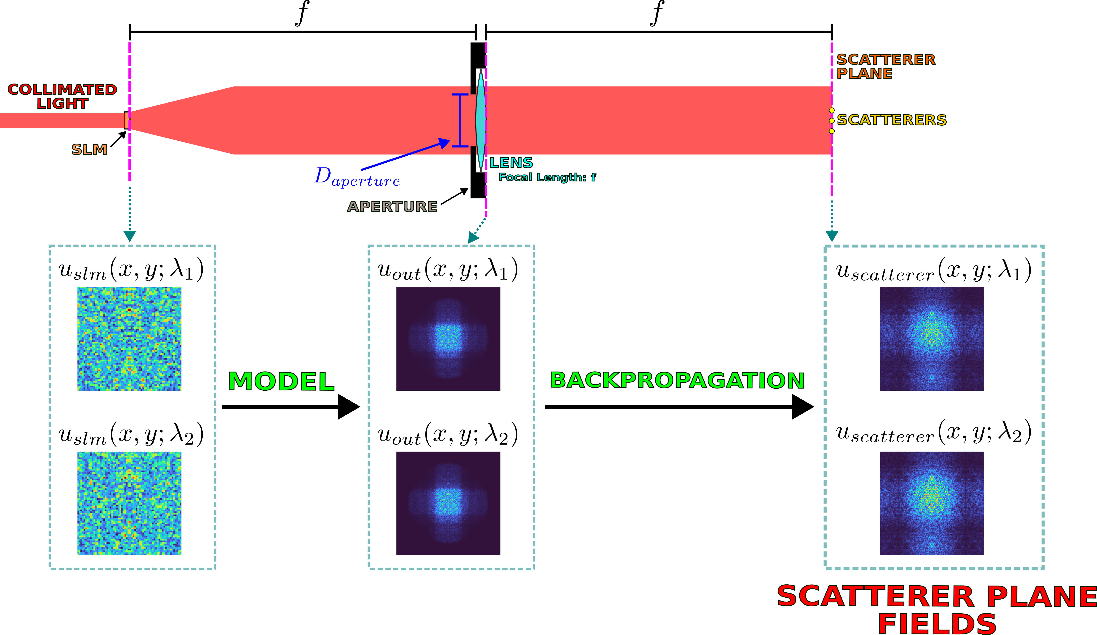
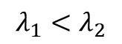
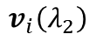
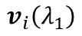
Backpropagation without Synthetic Wavelengths
$$λ_{1}<λ_{2}$$
$$v_{i}\left(λ_{1}\right)$$
$$v_{i}\left(λ_{2}\right)$$
Right-singular vectors
Notes:
Now, imagine that one wanted to use conventional DORT to image in this situation.
Also imagine that one does not explicitly know the aberrating medium, so it cannot be modeled during backpropagation.
Imagine that instead, one replaced the aberrating medium with free space.
One can derive SLM patterns from the right-singular vectors from DORT and project those patterns onto the SLM. One can then propagate through the model of the system, up until the output of the lens.
Then, one can backpropagate through free space to the scatterer plane to attempt to get images.

Slide 23
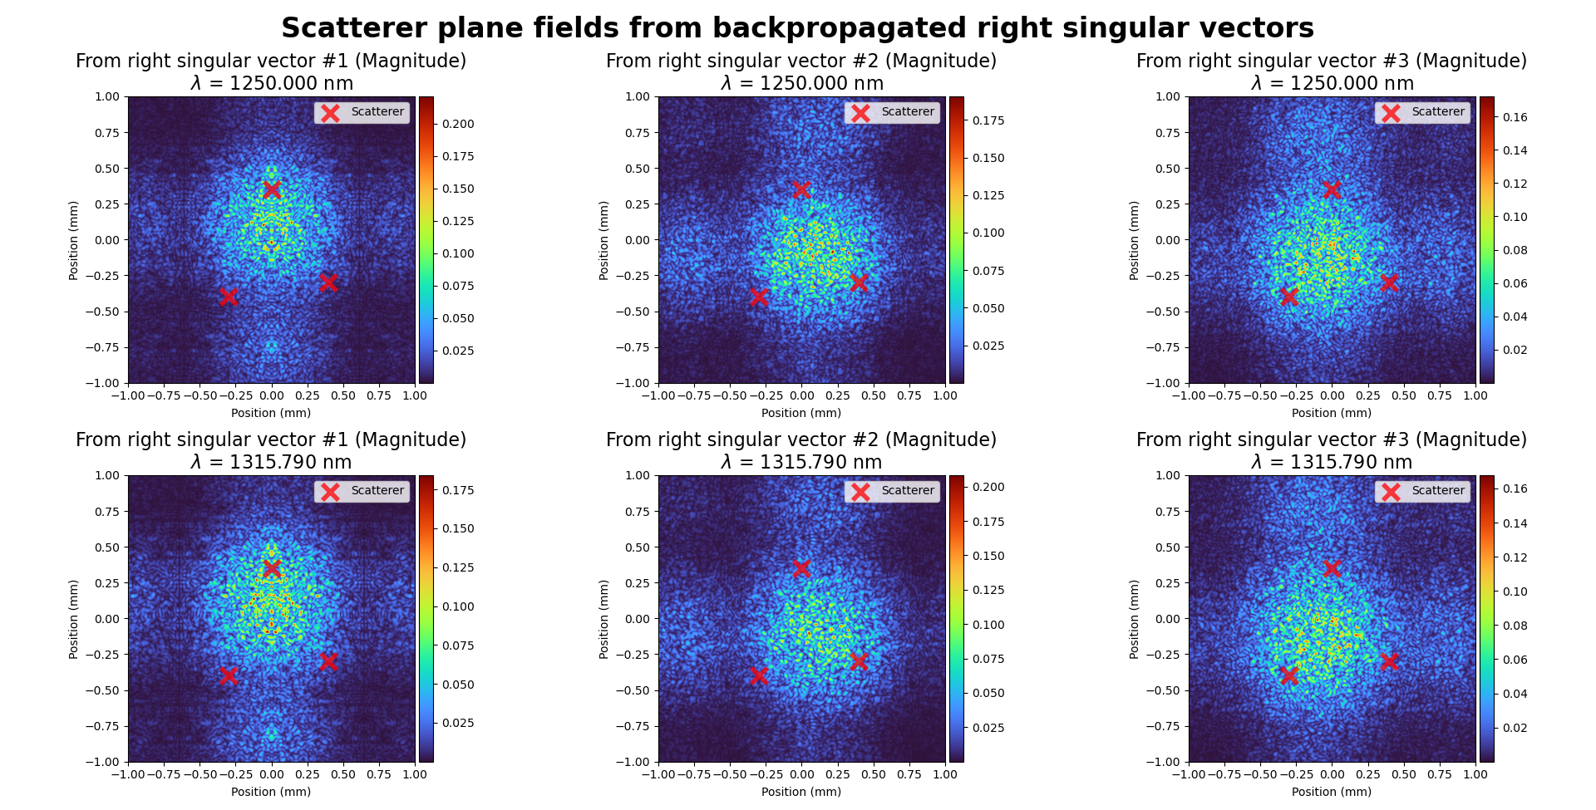
Results (Without Synthetic Wavelengths)
Notes:
These are the results of doing what was described on the previous slide. It can be seen that not modeling the aberrating layer, i.e. replacing the aberrating layer with free space, results in poor images. The fields are not focused on the scatterers and one cannot tell where the scatterers are from just looking at the fields.

Slide 24
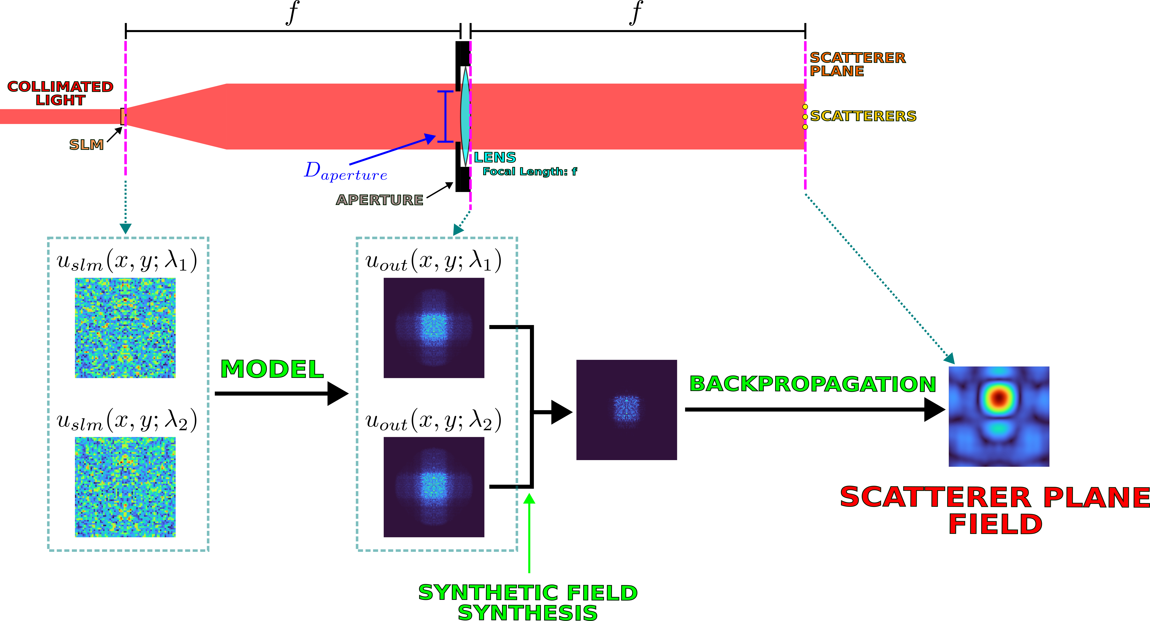
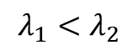
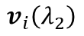
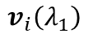
Backpropagation with Synthetic Wavelengths
$$λ_{1}<λ_{2}$$
$$v_{i}\left(λ_{1}\right)$$
$$v_{i}\left(λ_{2}\right)$$
$$u_{synth}\left(x,y;Λ\right)=u_{out}\left(x,y;λ_{1}\right) \text{⊙} u_{out}^{∗}\left(x,y;λ_{2}\right)$$
Right-singular vectors
Notes:
So how can one fix this? Well, one can again get the fields at the output of the lens. However, instead of backpropagating those fields, one can create a synthetic field using the formula for u_synth shown in the slide. In that formula, the dotted circle represents pointwise multiplication.
That synthetic field can be backpropagated at the synthetic wavelength through free space to the scatterer plane.

Slide 25
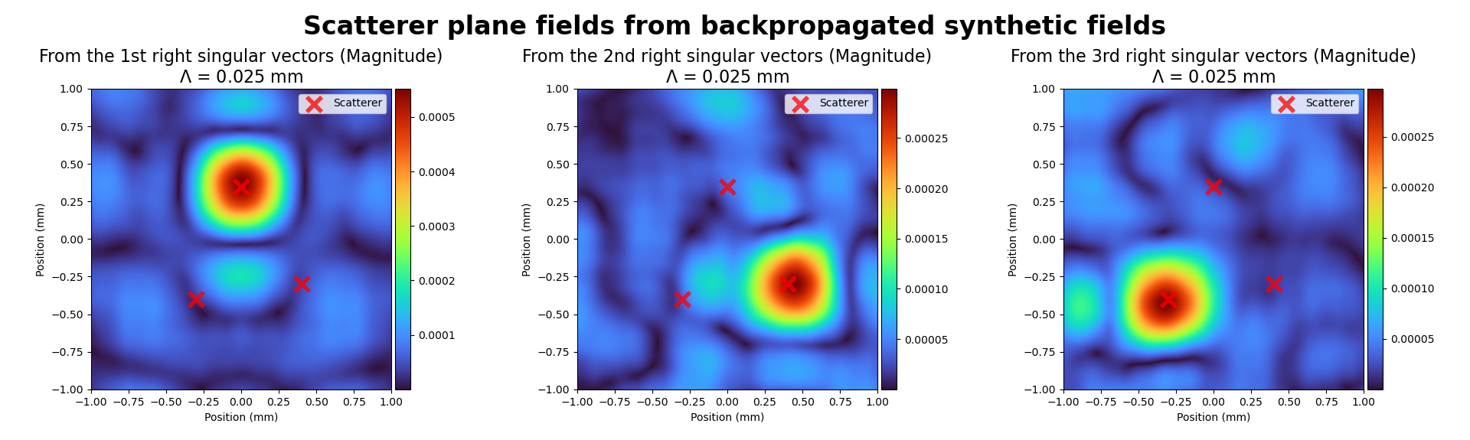
Results (With Synthetic Wavelengths)
Notes:
Doing this results in images of the scatterers. As one can see, the fields are focused around the locations of the scatterers.

Slide 26
Experiment Conclusions
Regular DORT – Fails
DORT + synthetic wavelengths – succeeds
Notes:
So, as one can see, regular DORT backpropagation fails to form images of scatterers when the aberrating layer is not modeled. However, combining DORT with synthetic wavelengths allows for backpropagation to form images of scatterers even without modeling the aberrating layer.

Slide 27
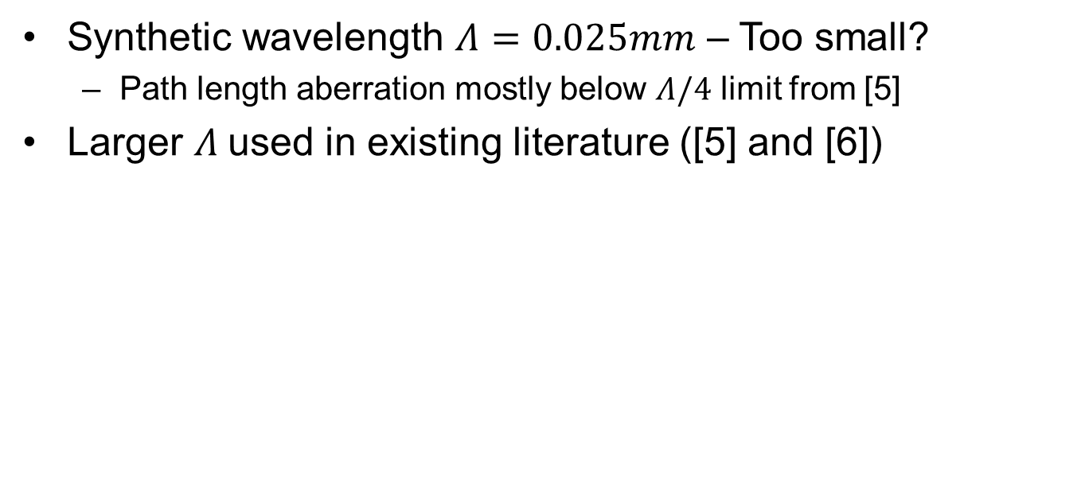
A note on synthetic wavelength size
Synthetic wavelength $Λ=0.025mm$ – Too small?
Path length aberration mostly below $Λ/4$ limit from [5]
Larger $Λ$used in existing literature ([5] and [6])
[5] F. Willomitzer, P. V. Rangarajan, F. Li, M. M. Balaji, M. P. Christensen, and O. Cossairt, “Fast non-line-of-sight imaging with high-resolution and wide field of view using synthetic wavelength holography,” Nature Communications, vol. 12, p. 6647, Nov 2021.
[6] Y. Wu, F. Li, F. Willomitzer, A. Veeraraghavan, and O. Cossairt, “WISHED: Wavefront imaging sensor with high resolution and depth ranging,” 2020 IEEE International Conference on Computational Photography (ICCP), 2020.
Notes:
Before moving on, it should be noted that the synthetic wavelength used in this simulation is quite small compared to what was used in existing literature, such as sources [5] and [6]. A small synthetic wavelength of 0.025mm was to reduce the size of the focus spot in the image.
Despite its short length, the synthetic wavelength seems to mostly meet the criterion specified in source [5]. Specifically, since the aberrating layer had a surface height standard deviation of 1.3 micrometers, the path length aberrations should have largely been less than a quarter of the synthetic wavelength in length.
However, the synthetic wavelength used may, in fact, be too small. In fact, the synthetic wavelengths in source [5] are at least an order of magnitude larger than what was used in this simulation. And, in source [5], speckle artifacts started degrading the image for the smaller synthetic wavelengths.
It should be noted though that the methodology in source [5] is different. It did not make use of the synthetic wavelength DORT method. Perhaps synthetic wavelength DORT is resilient at small synthetic wavelengths.
Or perhaps the fact that small points are being imaged makes the task of imaging easier, thus allowing for smaller synthetic wavelengths.
Or maybe this simulated experiment would fail in a real-life case as perhaps real-life cases need longer synthetic wavelengths.
But these are just possibilities.
Ultimately, I do not know if the use of a small synthetic wavelength, i.e. 0.025mm, would be an issue in a real-life experiment. If I were to continue with this research and do a real life experiment, I would be cognizant of the size of my synthetic wavelength as using too small of a synthetic wavelength can cause issues.

Slide 28
Conclusion
Promising results in simulation
Synthetic wavelength DORT can image small, discrete scatterers behind aberrating media?
No model for aberrating media required
Notes:
So how much can one conclude from this simulation? Admittedly, not too much since it is only simulation. A more convincing test would have been to do a real-life, physical experiment. Regardless, this simulation is a promising first step.
Ultimately, one can say that limited experimental evidence from simulation indicates that synthetic wavelength DORT may be able to be used to image small, discrete scatterers through aberrating media, without requiring an explicit model for the aberrating media.

Slide 29
References
[1] Boccara, and S. Gigan, “Measuring the transmission matrix in optics: An approach to the study and control of light propagation in disordered media,” Physical Review Letters, vol. 104, no. 10, 2010.
[2] C. A. Metzler, M. K. Sharma, S. Nagesh, R. G. Baraniuk, O. Cossairt, and A. Veeraraghavan, “Coherent inverse scattering via transmission matrices: Efficient Phase Retrieval Algorithms and a public dataset,” 2017 IEEE International Conference on Computational Photography (ICCP), 2017.
[3] M. K. Sharma, C. A. Metzler, S. Nagesh, R. G. Baraniuk, O. Cossairt, and A. Veeraraghavan, “Inverse scattering via transmission matrices: Broadband illumination and fast phase retrieval algorithms,” IEEE Transactions on Computational Imaging, vol. 6, p. 95–108, 2020.
[4] M. Fink and C. Prada, Detection and Imaging in Complex Media with the D.O.R.T. Method, pp. 107–134. Springer Berlin Heidelberg, 2002. From the book titled Imaging of Complex Media with acoustic and seismic waves.
[5] F. Willomitzer, P. V. Rangarajan, F. Li, M. M. Balaji, M. P. Christensen, and O. Cossairt, “Fast non-line-of-sight imaging with high-resolution and wide field of view using synthetic wavelength holography,” Nature Communications, vol. 12, p. 6647, Nov 2021.
[6] Y. Wu, F. Li, F. Willomitzer, A. Veeraraghavan, and O. Cossairt, “WISHED: Wavefront imaging sensor with high resolution and depth ranging,” 2020 IEEE International Conference on Computational Photography (ICCP), 2020.
[7] J. W. Goodman, Statistical Optics. Wiley, 2nd ed., 2015. Sections 7.1.1 and 8.2.
Notes:
Here are the references.

Slide 30
Extra Slides

Slide 31
Methodology
Combine two techniques:
DORT technique
Synthetic wavelengths
Use numerical backpropagation of fields
Result:
Images of small, discrete scatterers are obtained
Done in the optical regime
Notes:
So how does one image through aberrating media? Well, there is a fair amount of literature on that. However, this work focuses on a specific methodology. The methodology of this work involves using the DORT technique in conjunction with synthetic wavelengths to generate synthetic fields. These synthetic fields are then numerically backpropagated at the synthetic wavelength to form images of small, discrete scatterers.
It should be noted that this work is done in the optical regime, i.e. with light. The experiment done was performed in simulation.

Slide 32
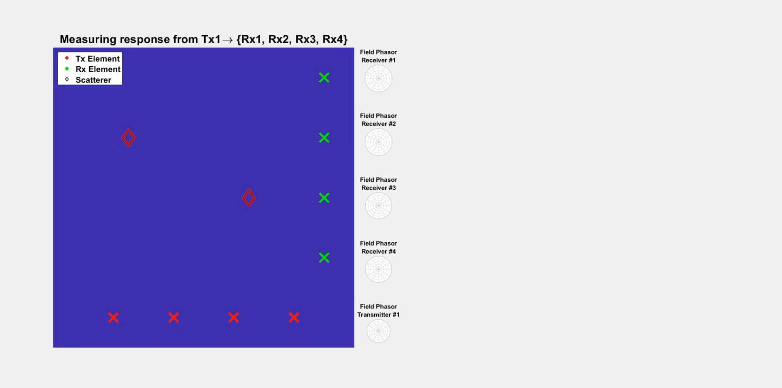
Transfer Matrix Measurement Process for a Single Frequency (For RF/Microwave and Acoustics)
Notes:
In the microwaves and radio frequency (RF) domain, as well as acoustics, transfer matrices can be measured relatively straightforwardly. This is because signals can be directly sampled in time, which is not the case for optical signals.
This video shows the process of how one might measure a transfer matrix at a single frequency for areas such as microwaves, RF, and/or acoustics.
[Play video]
[After the video is done]
Essentially, one transmits out of one transmitter and observes the field phasors at the receivers. This gives one column of the transfer matrix. One then repeats this for all of the transmitters, which gives the entire transfer matrix.
Note that the video shows measuring the transfer matrix at a single frequency. One can also transmit impulses or pulses, record time-domain responses, and take the discrete Fourier transform to get data for multiple frequencies.
As an aside, if one looks closely, one can see the convention that phasors rotate counter-clockwise in time was used in the animation on this slide. This convention is sometimes used in RF/microwaves, but the opposite convention is sometimes used in optics.

Slide 33
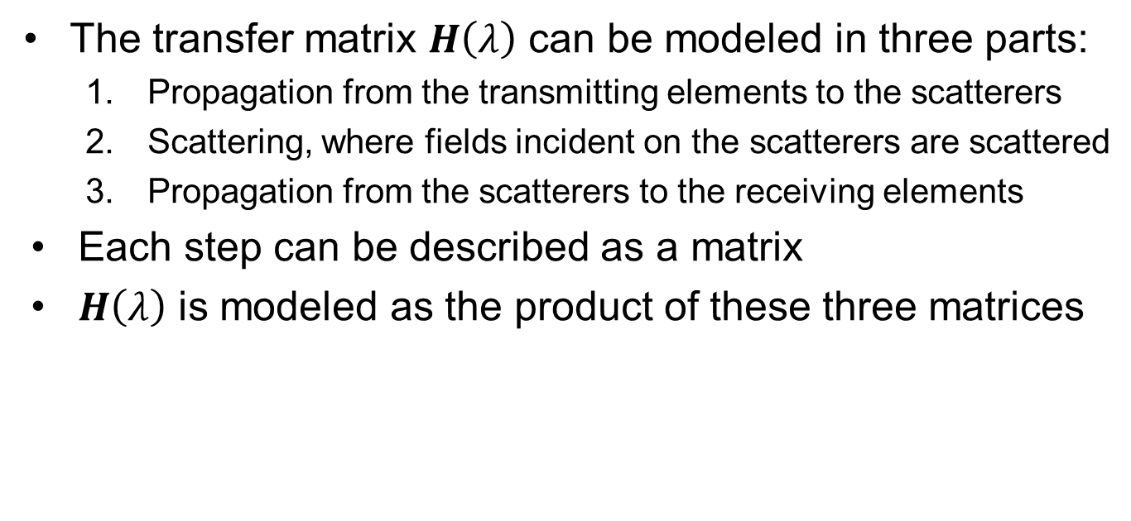
Transfer Matrix – DORT Model
The transfer matrix $H\left(λ\right)$ can be modeled in three parts:
Propagation from the transmitting elements to the scatterers
Scattering, where fields incident on the scatterers are scattered
Propagation from the scatterers to the receiving elements
Each step can be described as a matrix
$H\left(λ\right)$ is modeled as the product of these three matrices

Slide 34
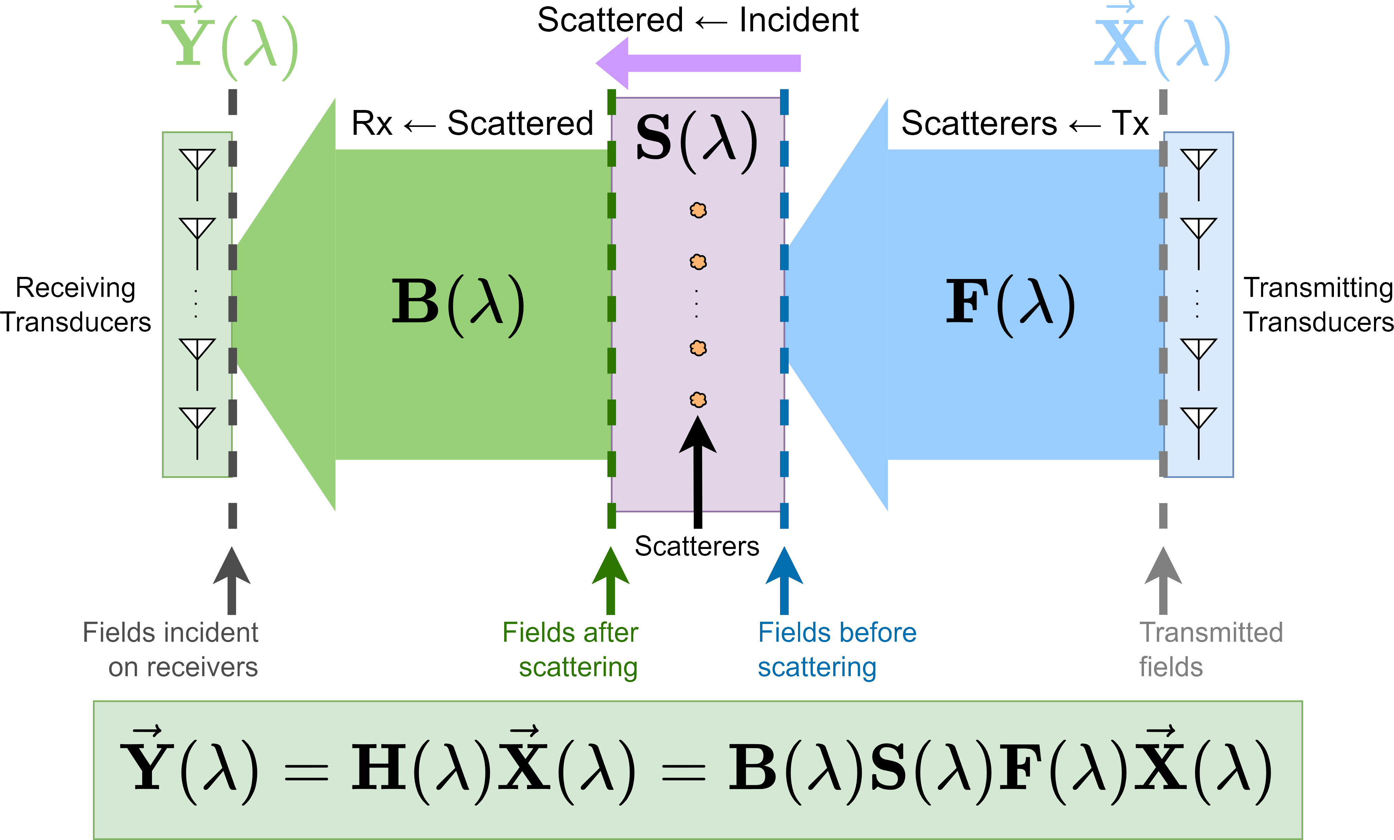
Transfer Matrix – DORT Model
Notes:
Assumes that energy does not flow directly from the transmitters to receivers

Slide 35
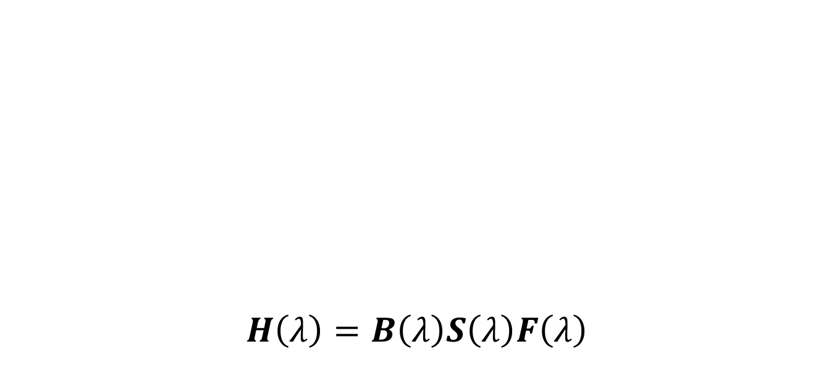
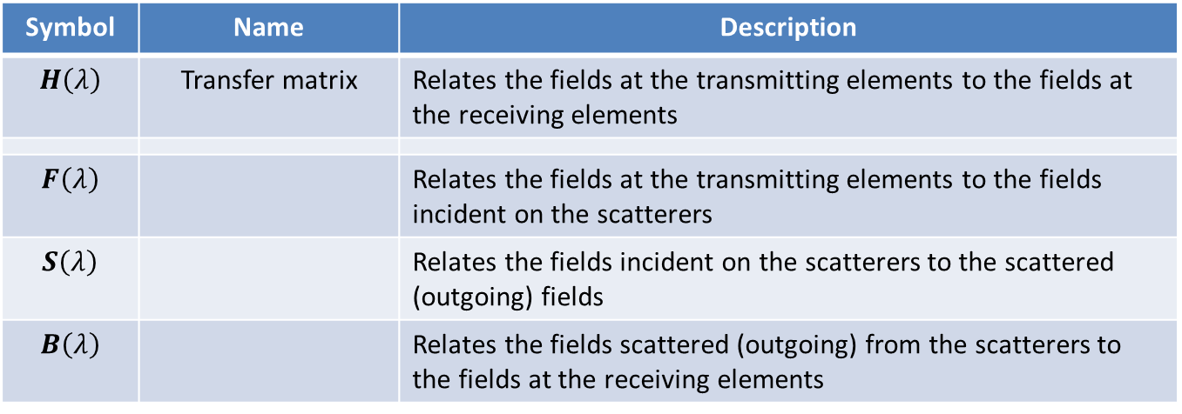
Transfer Matrix – DORT Model
$$H\left(λ\right)=B\left(λ\right)S\left(λ\right)F\left(λ\right)$$
Symbol | Name | Description
$$H\left(λ\right)$$ | Transfer matrix | Relates the fields at the transmitting elements to the fields at the receiving elements
$$F\left(λ\right)$$ |  | Relates the fields at the transmitting elements to the fields incident on the scatterers
$$S\left(λ\right)$$ |  | Relates the fields incident on the scatterers to the scattered (outgoing) fields
$$B\left(λ\right)$$ |  | Relates the fields scattered (outgoing) from the scatterers to the fields at the receiving elements

Slide 36
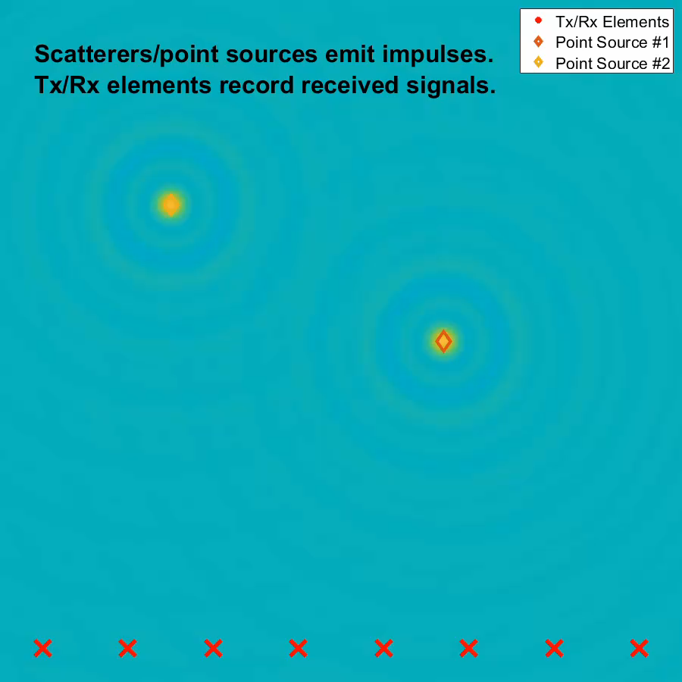
An Aside: Time-Reversal Mirroring
Process
Scatterers emit impulses (OR the medium is excited)
Transmit/receive (Tx/Rx) elements record received signals
Transmit/receive elements retransmit time-reversed versions of received signals
Retransmitted time-reversed signals tend to focus on scatterers

Slide 37
Old Slides

Slide 38
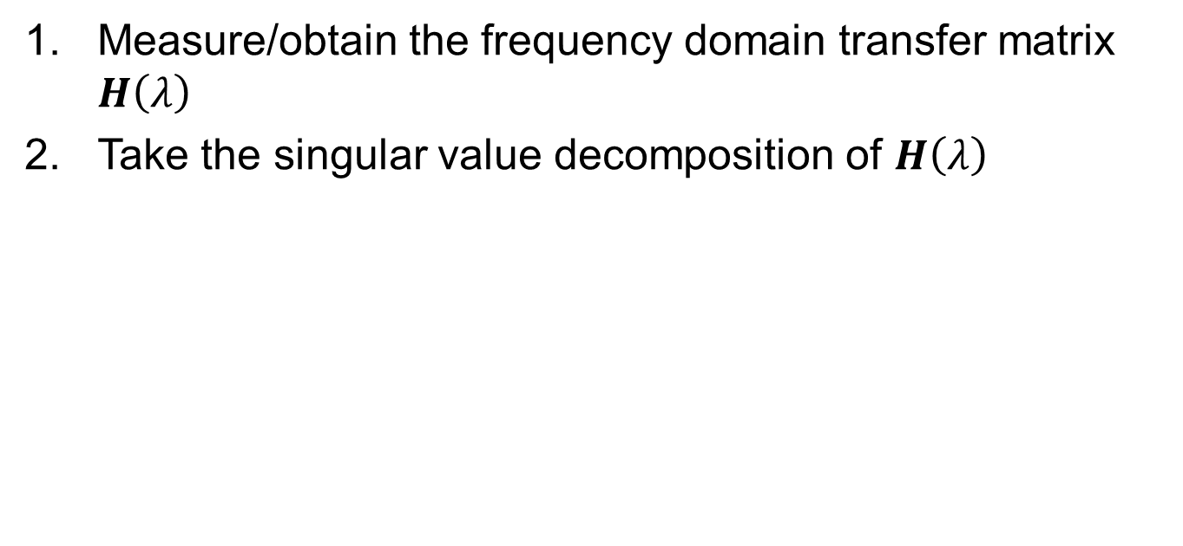
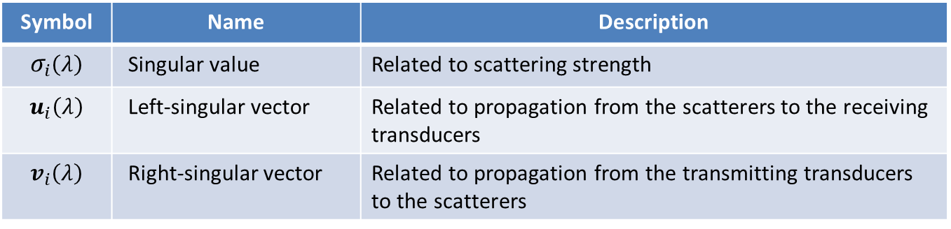
Performing DORT
Measure/obtain the frequency domain transfer matrix $H\left(λ\right)$
Take the singular value decomposition of $H\left(λ\right)$
Symbol | Name | Description
$$σ_{i}\left(λ\right)$$ | Singular value | Related to scattering strength
$$u_{i}\left(λ\right)$$ | Left-singular vector | Related to propagation from the scatterers to the receiving transducers
$$v_{i}\left(λ\right)$$ | Right-singular vector | Related to propagation from the transmitting transducers to the scatterers

Slide 39
Interpreting DORT
Singular values – related scattering strength
Right-singular vectors
Defines inputs that will (ideally) focus fields on individual scatterers
Can detect and locate scatterers by simulating sending out these signals (i.e. backpropagating)

Slide 40
Challenges
Focusing on a point is improved when:
Aperture is large
Focus point is close to the aperture
However…
Large apertures → larger simulations → more memory (VRAM) usage
Close focus → phase in aperture plane must change more rapidly → denser sampling required

Slide 41
Focus spot size: Aperture size, distance
Aperture size: Focus spot size, memory
Distance: Focus spot size, sampling density
Sampling density: Aperture size
 | Focus Spot Size | Memory Usage | Required Sampling Density
↑ Focus Distance | ↑ | ↑ | ↓
↑ Aperture Size | ↓ | ↑ | ↑
↑ Synthetic Wavelength | ↑ | N/A* | N/A*
*Unless the synthetic wavelength is comparable to the sample spacing

Slide 42
Synthetic Wavelength DORT Process
Obtain the transfer matrix for two closely spaced wavelengths
Perform DORT (take SVDs of transfer matrices)
Take a pair of singular vectors (one from each wavelength) and derive fields
Derive a synthetic field from the fields
Backpropagate the synthetic field
Obtain images from the backpropagated synthetic field
Notes:
Synthetic wavelength DORT requires that one has the transfer matrix for two closely spaced wavelengths.
DORT is performed, yielding a set of singular vectors.
One takes a pair of singular vectors, and from those singular vectors, derives fields.
These fields are then used to derive a synthetic field.
The synthetic field is then backpropagated, and images are obtained.

Slide 43
Limitations of the Simulation
Scalar wave approximation
Aberrating layer model [7] assumes a thin structure and/or paraxial rays
Scatterers modeled as opaque spots on an amplitude mask
Partial reflection and transmission from beamsplitter is not modeled
And other limitations
Notes:
However, there are limits to this simulation.
First of all, scalar waves are simulated. This is not entirely accurate to reality as electromagnetic waves are vector waves.
The aberrating layer model is a random thickness model that follows what is described in source [7]. It is implemented as a phase mask, where the phase shift is commensurate with, i.e. proportional to, the thickness at a point. This model assumes a thin structure and/or paraxial rays.
Scatterers are modeled as opaque spots on an amplitude mask, which might not be the best model of a scatterer.
Partial reflection and transmission from beamsplitters is also not modeled.
These are just some of the limitations of the model I used for my simulation. There are other limitations as well.

Slide 44
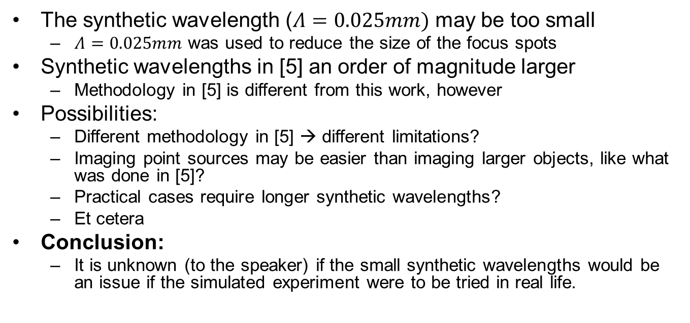
A note on synthetic wavelength size
The synthetic wavelength ($Λ=0.025mm)$ may be too small
$Λ=0.025mm$ was used to reduce the size of the focus spots
Synthetic wavelengths in [5] an order of magnitude larger
Methodology in [5] is different from this work, however
Possibilities:
Different methodology in [5] → different limitations?
Imaging point sources may be easier than imaging larger objects, like what was done in [5]?
Practical cases require longer synthetic wavelengths?
Et cetera
Conclusion:
It is unknown (to the speaker) if the small synthetic wavelengths would be an issue if the simulated experiment were to be tried in real life.
Notes:
Before moving on, it should be noted that the synthetic wavelength used in this simulation is quite small compared to what was used in existing literature, such as sources [5] and [6]. A small synthetic wavelength of 0.025mm was to reduce the size of the focus spot in the image.
However, the synthetic wavelength used may, in fact, be too small. In fact, the synthetic wavelengths in source [5] are an order of magnitude larger than what was used in this simulation. And, in source [5], speckle artifacts started degrading the image for the smaller synthetic wavelengths.
It should be noted though that the methodology in source [5] is different. It did not make use of the synthetic wavelength DORT method. Perhaps synthetic wavelength DORT is resilient at small synthetic wavelengths.
Or perhaps the fact that small points are being imaged makes the task of imaging easier, thus allowing for smaller synthetic wavelengths.
Or maybe this simulated experiment would fail in a real-life case as perhaps real-life cases need longer synthetic wavelengths.
But these are just possibilities.
Ultimately, I do not know if the use of a small synthetic wavelength, i.e. 0.025mm, would be an issue in a real-life experiment. If I were to continue with this research and do a real life experiment, I would be cognizant of the size of my synthetic wavelength as using too small of a synthetic wavelength can cause issues.

